Slide 1
Design for Operations
Patrick El-Azem
Cloud Solution Architect, Microsoft
Azure Data/AI Focus
LinkedIn: pelazem
github: plzm

Slide 2
Design for Operations (10-15%)
Design an application monitoring and alerting strategy
Determine the appropriate Microsoft products and services for monitoring applications on Azure
Define solutions for analyzing logs and enabling alerts using Azure Log Analytics
Define solutions for analyzing performance metrics and enabling alerts using Azure Monitor
Define a solution for monitoring applications and enabling alerts using Application Insights
Design a platform monitoring and alerting strategy
Determine the appropriate Microsoft products and services for monitoring Azure platform solutions
Define a monitoring solution using Azure Health, Azure Advisor, and Activity Log
Define a monitoring solution for Azure Networks using Log Analytics and Network Watcher service
Monitor security with Azure Security Center
Design an operations automation strategy
Determine when to use Azure Automation, Chef, Puppet, PowerShell, Desired State Configuration (DSC), Event Grid, and Azure Logic Apps
Define a strategy for auto-scaling
Define a strategy for enabling periodic processes and tasks

Slide 3
Azure is a cloud partnership
Your Organization
Balance of responsibility
Cloud architectures
Design for high availability
Leverage Microsoft resources
MICROSOFT RESOURCES
Service resiliency guide
Cloud dev patterns & practices
Proactive and reactive support
CLOUD PLATFORM RELIABILITY
Availability, change orchestration, monitoring, communications, recommendations

Slide 4
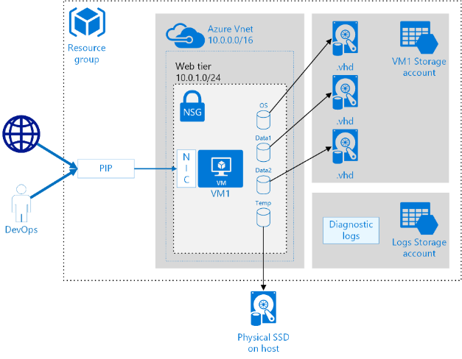
Operationalizing Azure Workloads
ARM TEMPLATES
Integration
Declarative config-as-code
3rd party automation tools
COMMAND LINE
PowerShell
RESOURCE GROUPS
Lifecycle management
Organization
Customization
REST API / SDKS
Cross platform Azure CLI
PORTAL
Owner Setup
Management plane
DEPLOYMENT
ADVISOR
Monitor good practices
Security, cost, performance
MONITOR
Log aggregation and search
Customizable dashboards
Threat intelligence reporting
Security policy compliance
LOG ANALYTICS
Alert management
Autoscale, audit management
SECURITY CENTER
PROTECTION
AZURE AD
KEY VAULT
Multi-factor authentication
Data encryption
Key/password management
BACKUP
VM backups
File and folder backups
SITE RECOVERY
Regional protection
Failover and failback
Identity Protection
MONITORING
AUTOMATION
Standardize recurring tasks
Automate remediation
SUBSCRIPTIONS
Security boundary
Billing boundary
POLICIES
Estimates, tags reports
Budgets, chargebacks
Management groups
Security roles
COST MANAGEMENT
Usage compliance
Enforce standards
ROLE BASED ACCESS
CONTROLS

Slide 5
Design an application monitoring and alerting strategy

Slide 6

What does visibility mean to you?
Diagnose problems across my app, VMs, networks, and PaaS services
Show exec dashboards of application SLAs & KPIs
Understand & optimize performance of my app
Track usage, engagement & retention of my app
Detect & debug errors in my apps
Is there is a security threat!!!!!
Notes:
Monitoring means different things to different people. While you might be focused just on application monitoring, there are cases where you might want to also look at infrastructure & platform for correlations, and that is where “Azure Monitoring & Analytics” provides an integrated consolidated solution.

Slide 7
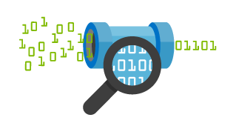
Azure Monitor
Native monitoring and diagnostics for all your Azure resources
Set up alerts and take automated actions
Metric alerts (near real-time in preview)
Activity log alerts
Diagnose operational issues quickly
Integrate with your existing tools
https://aka.ms/azmonitor
Notes:
Get the granular, up-to-date monitoring data you need—all in one place
Monitor your Azure resources with detailed logs
Set up alerts and take proactive, automated actions
Use flexible configuration and data consumption options
Integrate with analytics and notification tools familiar to you
the Azure service that operates as a consolidated pipeline for all monitoring data from Azure services. It gives you access to performance metrics and events that describe the operation of the Azure infrastructure and any Azure services you are using. Azure Monitor is a monitoring data pipeline for your Azure environment, and offers that data directly into Log Analytics as well as 3rd party tools where you can gain insight into that data and combine it with data from on premises or other cloud resources.

Slide 8
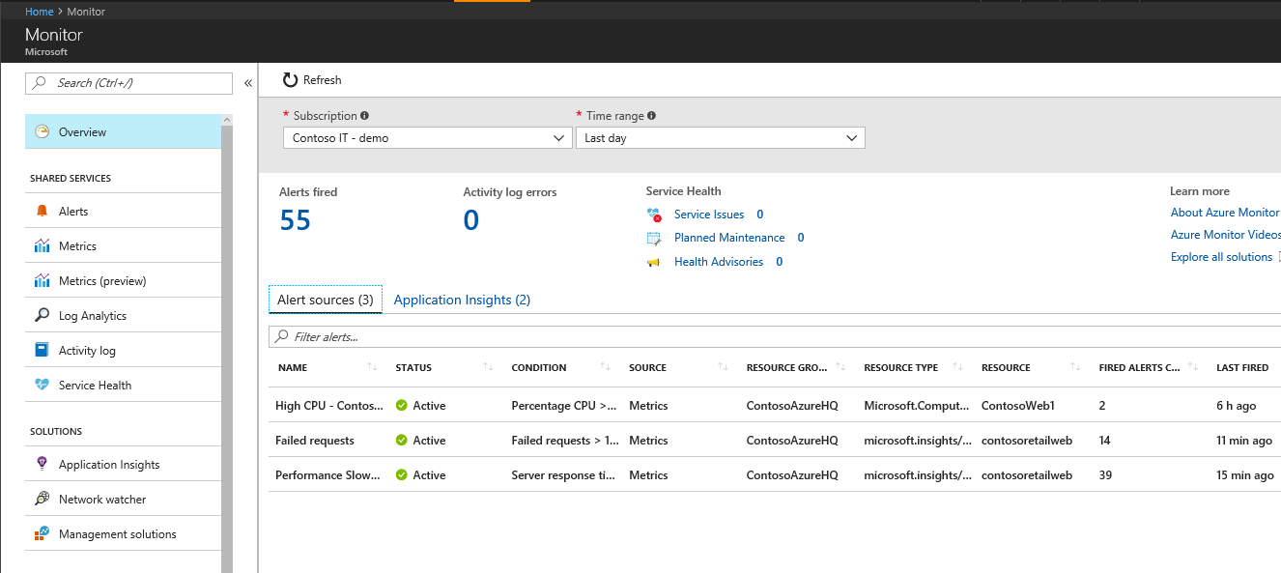
Azure Monitor
Metrics
Alerts
Autoscale
Activity Log
Action Groups
Diagnostic Logs

Slide 9
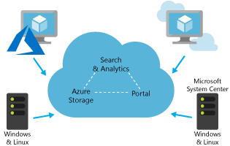
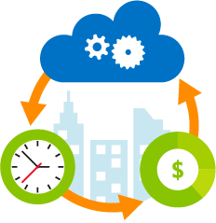
Log Analytics
Collect and correlate data from multiple sources
Collect and analyze Azure activity logs
Customize dashboards to focus on what matters most to you
Perform rich data exploration with interactive queries
Use smart analytics powered by machine learning
Turn insights into action with built-in notification and automation
Notes:
Transform your log data into insights and action
Quickly connect and collect log data from multiple sources
Correlate and analyze using powerful machine learning constructs
Search and query interactively using an expressive language
Develop deep insights using purpose-built management solutions
formerly known as OMS Log Analytics, is an Azure service that ingests log and metric data from Azure services (via Azure Monitor), Azure VMs, and on-premises or other cloud infrastructure and offers flexible log search and out-of-the box analytics on top of this data. It provides rich tools to analyze data across sources, allows complex queries across all logs, and can proactively alert on specified conditions. You can even collect custom data into its central repository so you can query and visualize it. You can also take advantage of Log Analytic's built-in solutions to immediately gain insights into the security and functionality of your infrastructure.

Slide 10
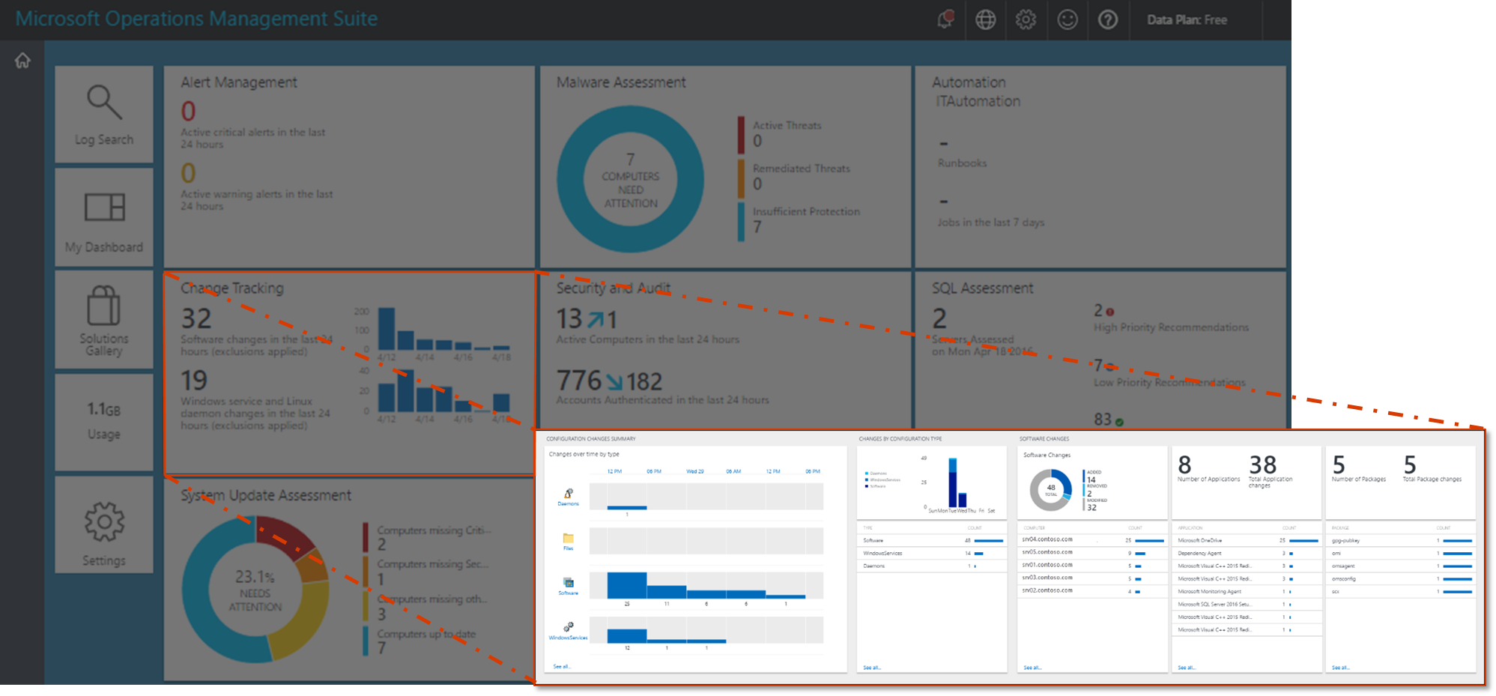
Log Analytics – Monitor Azure, AWS, On-Prem
Log Search
Utilize a powerful query language with joins and advanced date-time analysis
Dashboards
Pre-configured and custom dashboards based on log search queries
Solutions
A collection of logic, visualization, and data acquisition rules for deep insights
Drill Through
Detailed drill through reports for each dashboard tile
Advanced
Alerts, targeting, computer groups, custom logs, data retention

Slide 11
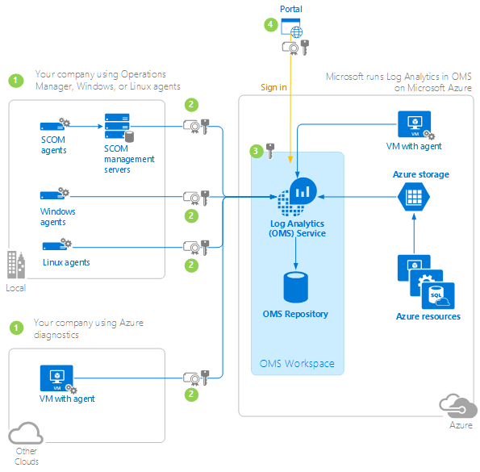
Log Analytics Workflow
Configure Microsoft Monitoring Agents (MMA)
Windows VMs, Linux VMs, Azure resources; supports HTTP forward proxy
Integrate with SCOM or SCCM for additional functionality
Data is compressed before being sent over the wire
Send data to the Log Analytics Service
OMS service exposes public REST endpoint over TLS (SSL 3)
Agents use certificate-based authentication
Private keys are managed by Microsoft and rotated every 90 days
Configure Log Analytics Workspaces
Workspace = container of aggregated log data
Factors: region, billing, isolation, configuration
Agents can send data to multiple workspaces, near real time intervals
Consume dashboards, reports, alerts
Solution gallery provides turnkey configuration scenarios
Query syntax for advanced data search
Log integrator to export data to external systems

Slide 12
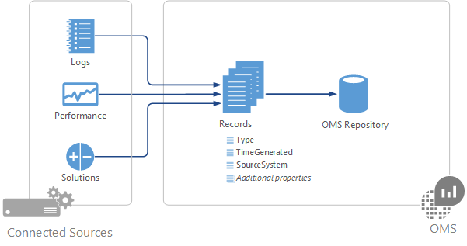
Log Analytics Data Sources
Custom Logs
Delimited text files, parsed and mapped to custom fields
Windows Event Logs
Filter by log name and event severity
Windows/Linux Performance Counters
Size = 1 MB x (# counters) x (# agents) x (# instances)
Windows IIS Logs
Supports W3C format, 15 minute sampling
Syslog
Filter by faculty name and event severity
Linux OMS Agent
Custom JSON data
Collectd performance data
Nagios and Zabbix alerts

Slide 13
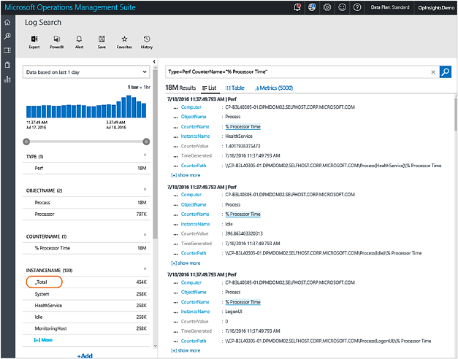
Log Analytics Query Language
Free text searchable fields (grey)
Searchable Fields (blue)
Filters: Type, EventName, Computer, CounterName, CounterValue, InstanceName
Operators: AND, OR, NOT, Piping
Commands: SELECT, WHERE, MEASURE, DISTINCT, IN
Computer Groups, Scope Configurations

Slide 14
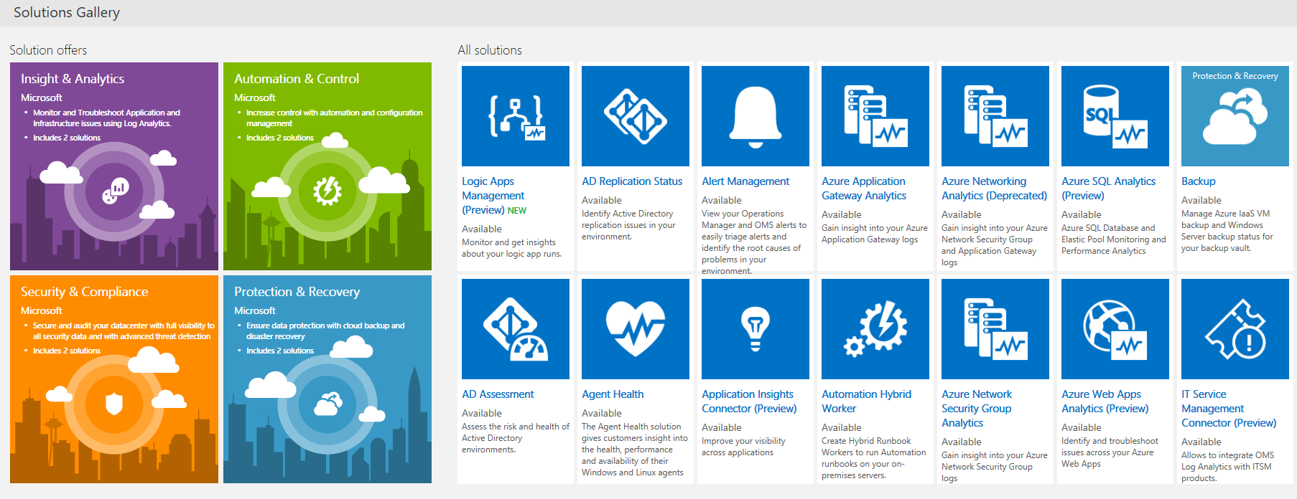
Log Analytics Solutions
Log Analytics Management Solution Gallery

Slide 15
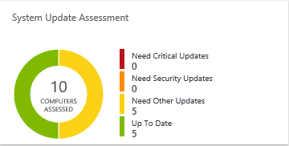
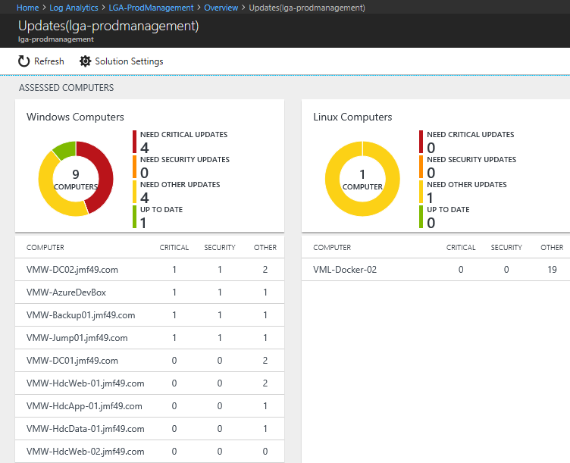
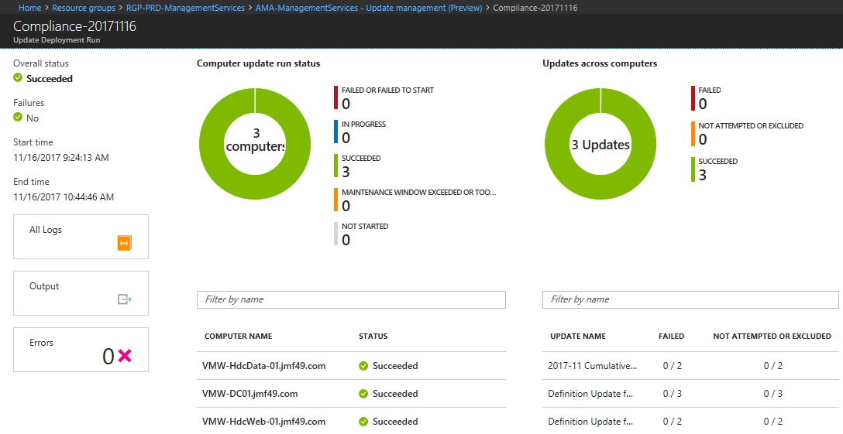
Log Analytics Solutions: Update Management
Overall Assessment (dashboard tile)
Per-Computer Assessment (drill-through)
Schedule Updates (specialty function)

Slide 16
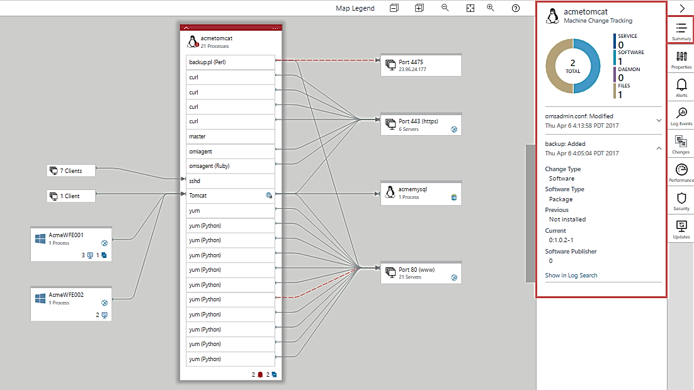
Log Analytics Solutions: Service Map

Slide 17
Azure Log Analytics: More Info
Log Search:
Capabilities: full piping language, search-time field extractions, advanced joins, date/time functions, advanced ML algorithms
Tools: advanced analytics portal, better integration with Power BI, consistency with other Azure services (app insights)
Workspaces Guidance
A container where data is collected, aggregated, analyzed and presented in the portal
A geographic location for data residency
Granularity for billing
Data isolation
Scope for configuration
Consolidate Views Across Workspaces:
Search API via PowerShell or REST
Cross Workspace Queries
PowerBI Power Query M language
Log Analytics Portals
Log Search Portal: part of the Azure management portal, contains legacy language converter
Advanced Analytics portal: a dedicated portal that provides unique advanced search functionality
OMS portal: a legacy portal that is being deprecated

Slide 18
Application Insights
Application Performance Management Service for Web Developers
Detect, diagnose issues in Web apps and services
Out-of-box and custom events
Alerts through email or webhooks
Diagnose exceptions and performance issues
Perform root cause analysis, initiate Automation Runbook
Live application monitoring
HTTP metrics
Dependency (e.g. SQL) response times
Log tracing
View and Session counts
Server performance
Availability tests
Notes:
https://docs.microsoft.com/en-us/azure/application-insights/app-insights-overview
Application Insights is an extensible Application Performance Management (APM) service for web developers on multiple platforms.
Use it to monitor your live web application. It will automatically detect performance anomalies.
It includes powerful analytics tools to help you diagnose issues and to understand what users actually do with your app.
It's designed to help you continuously improve performance and usability. It works for apps on a wide variety of platforms including .NET, Node.js and J2EE, hosted on-premises or in the cloud. It integrates with your devOps process, and has connection points to a variety of development tools.
Request rates, response times, and failure rates
Performance counters from your Windows or Linux server machines, such as CPU, memory, and network usage.
Page views and load performance - reported by your users' browsers.
Dependency rates, response times, and failure rates - Find out whether external services are slowing you down.

Slide 19






Application Insights Ecosystem
Ingestion
Exploration
Export & Correlation
Application Insights
Microsoft Azure Portal
OMS Connector
Power BI
Open Source SDKs
Status Monitor
Azure Extensions
Azure Monitor
Application Map
Live Metrics Stream
Profiler & Debugger
Microsoft Azure dashboards
Blob storage
Visual Studio Team Services
SCOM MP Open Schema
Visual Studio IDE
Analytics Portal
Data Access APIs
Support
ASP.NET
ASP.NET Core
Java - J2EE
Windows Desktop
WCF
JavaScript
Node.JS
PHP
Python
Ruby
Angular
Docker
Kubernetes
Dynamics CRM
Azure Web Apps
Azure Cloud Services
Azure VMs
Azure Functions
Azure Service Fabric
Glimpse
Spring
Log4Net/NLog
Log4J/Logback
System.Diagnostics
Semantic Logging (SLAB)
ETW/EventSource
LogStash
Collectd
Concrete
Drupal
Joomla
SharePoint
WordPress
Orchard
OSS/Public Endpoints
…

Slide 20
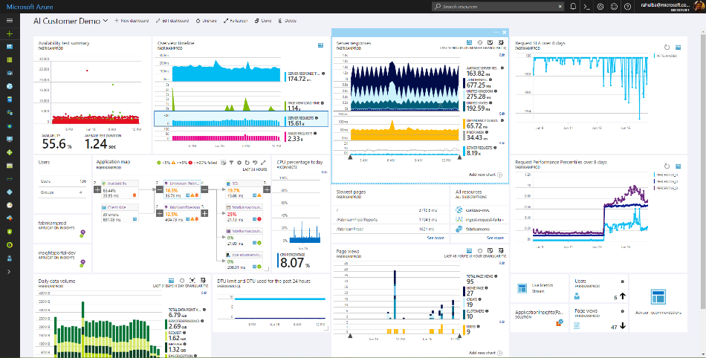
Application Insights
Health Check
Monitor & Optimize
Detect & Debug
ML/Data Analytics
Generate Alerts
Export & Correlate
Customer Insights
Take Actions

Slide 21
Application Map
Notes:
The map shows:
Availability tests
Client-side component (monitored with the JavaScript SDK)
Server-side component
Dependencies of the client and server components
You can expand and collapse dependency link groups:
https://docs.microsoft.com/en-us/azure/application-insights/app-insights-app-map

Slide 22
Application Map - Recommendations
Notes:
The map shows:
If you use SQL Azure, there's an icon that shows when there are recommendations on how you can improve performance.
https://docs.microsoft.com/en-us/azure/application-insights/app-insights-app-map

Slide 23
Design a platform monitoring and alerting strategy

Slide 24
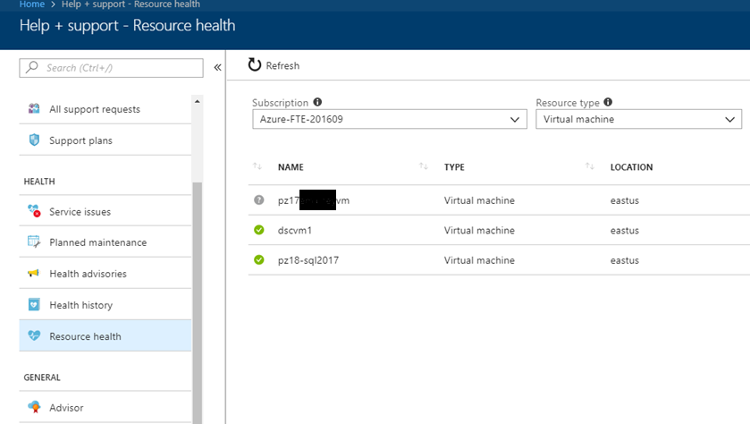
Azure Resource Health
Diagnose and get support when an Azure issue impacts your resources
Guides you through solutions to mitigate issues with Azure resources
https://aka.ms/azureresourcehealth

Slide 25
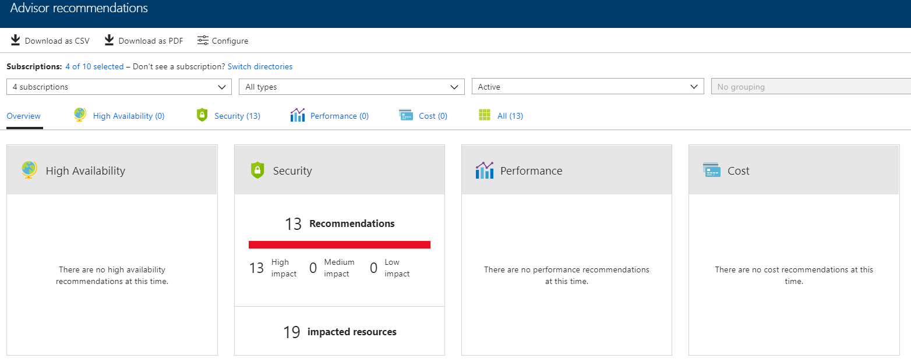
Azure Advisor
Personalized recommendation guide to best practices
Optimize across high availability, performance, security, and cost
https://aka.ms/azureadvisor

Slide 26
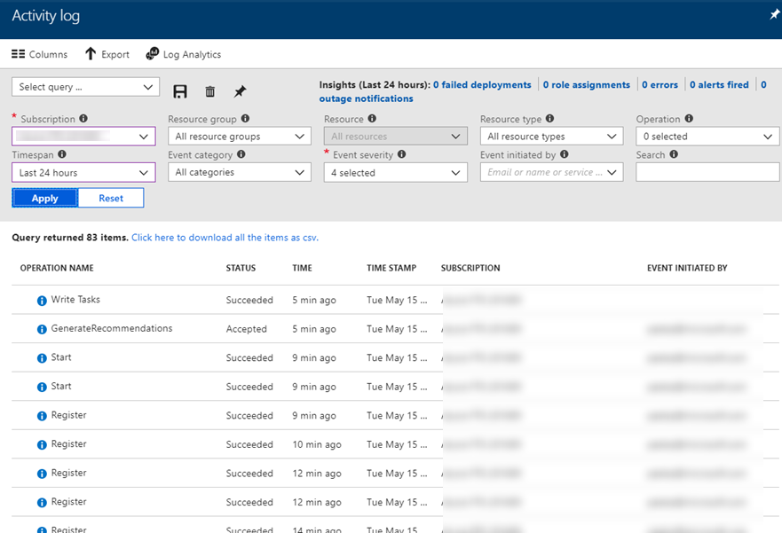
Azure Activity Log
Control Plane Log
Azure Resource operations
Azure Resource Manager operational data
Service Health events
“Who Did What When”
https://aka.ms/azactivitylog

Slide 27
Network Watcher
Monitor
Monitor communication between a VM and an endpoint
View resources in a virtual network and their relationships
Diagnostics
Diagnose network traffic problems to/from a VM
VM network routing, connections, packet capture
Virtual Network gateway connection diagnosis
Latencies between Azure regions and internet service providers
Effective network interface security rule → NIC, containing subnet, aggregate set
Metrics
Overview number of network resources created in subscription/region
Logs
Network security group traffic analytics
Network resource diagnostic logs
Network Watcher Docs

Slide 28
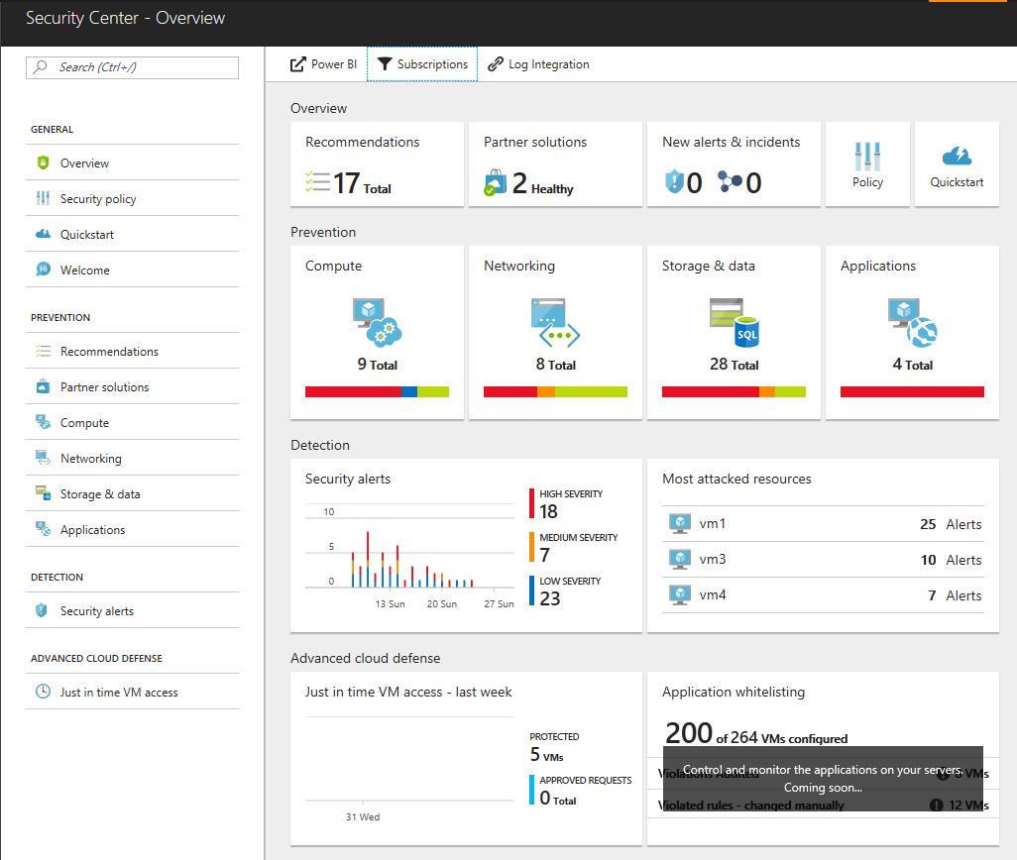
Azure Security Center
Partner Solutions
Third party solutions integrated in ASC that align to recommendations.
New
Summarize recent recommendations and security alerts in one list.
Recommendations
All prevention recommendations and partner solutions in one list.
Policy
Configure baseline standards for subscriptions and resource groups.
Prevention
Compliance drift from policy standards with potential resolutions.
Security Alerts
All Azure security alerts summarized in a single list for all subscriptions.
JIT VM Access
Open firewall ports through time-based rules with approval workflow.

Slide 29
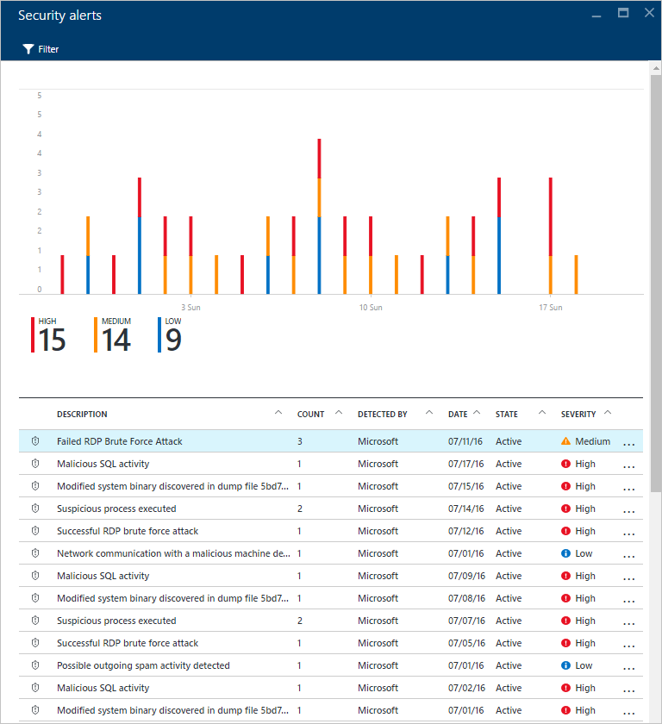
Detect
Threat Intelligence
Intelligent Security Graph
Behavioral Analytics
Learn threat patterns using machine learning algorithms against massive datasets
Anomaly Detection
Establish customer baselines from regular usage
Microsoft Digital Crimes Unit
Microsoft Security Response Center
External security feeds
Telemetry from Microsoft services (Azure, Office 365, outlook.com, CRM online, MSN.com)
Analyze logs to identify compromised resources
Apply machine learning models to identify outliers

Slide 30
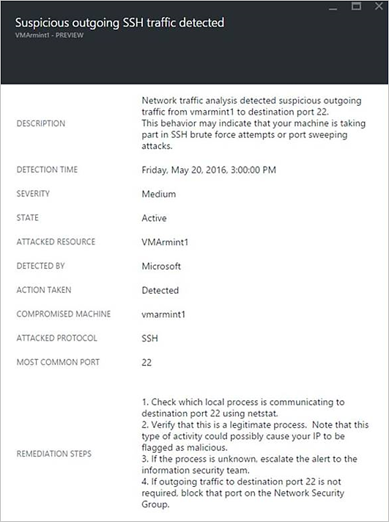
Respond
ALERT TYPES
Crash analysis
Shellcode discovered
Module hijacking discovered
Masquerading Windows module detected
Modified system binary discovered
Suspicious process executed
Multiple domain accounts queried
Anomalous mix of upper and lower case characters
Suspected Kerberos Golden Ticket attack
Suspicious account created
Suspicious firewall rule created
Suspicious combination of HTA and PowerShell
Suspicious outgoing traffic detected
Network communication with a malicious machine
Possible outgoing denial-of-service attack detected
Potential SQL injection
Vulnerability to SQL injection
Unusual access from unfamiliar location
Log clear events
PNP device plugged from unknown device
Alerts which are not actionable

Slide 31
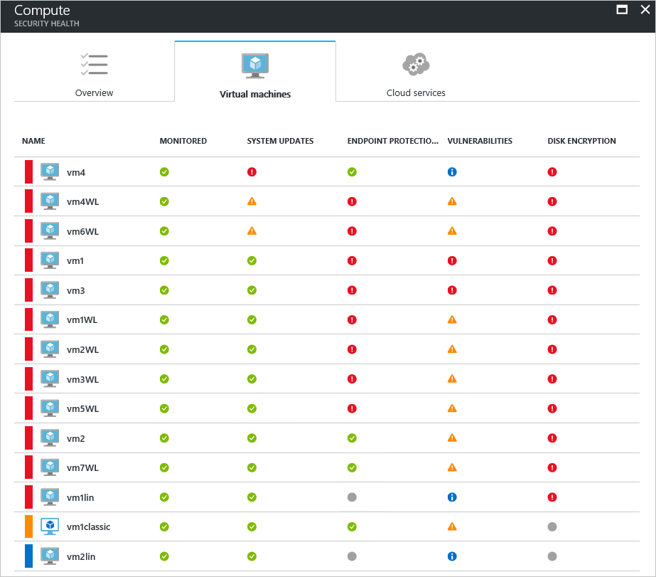
Prevent
RECOMMENDATIONS
Enable data collection for subscriptions
Remediate OS vulnerabilities
Apply system updates
Apply a Just-In-Time network access control
Reboot after system updates
Add a web application firewall
Finalize application protection
Add a Next Generation Firewall
Route traffic through NGFW only
Install Endpoint Protection
Resolve Endpoint Protection health alerts
Enable Network Security Groups on subnets or virtual machines
Restrict access through Internet facing endpoint
Enable auditing and threat detection on SQL servers
Enable auditing and threat detection on SQL databases
Enable Transparent Data Encryption on SQL databases
Enable VM Agent
Apply disk encryption
Provide security contact details
Update OS version
Vulnerability assessment not installed
Remediate vulnerabilities
Enable encryption for Azure Storage Account

Slide 32
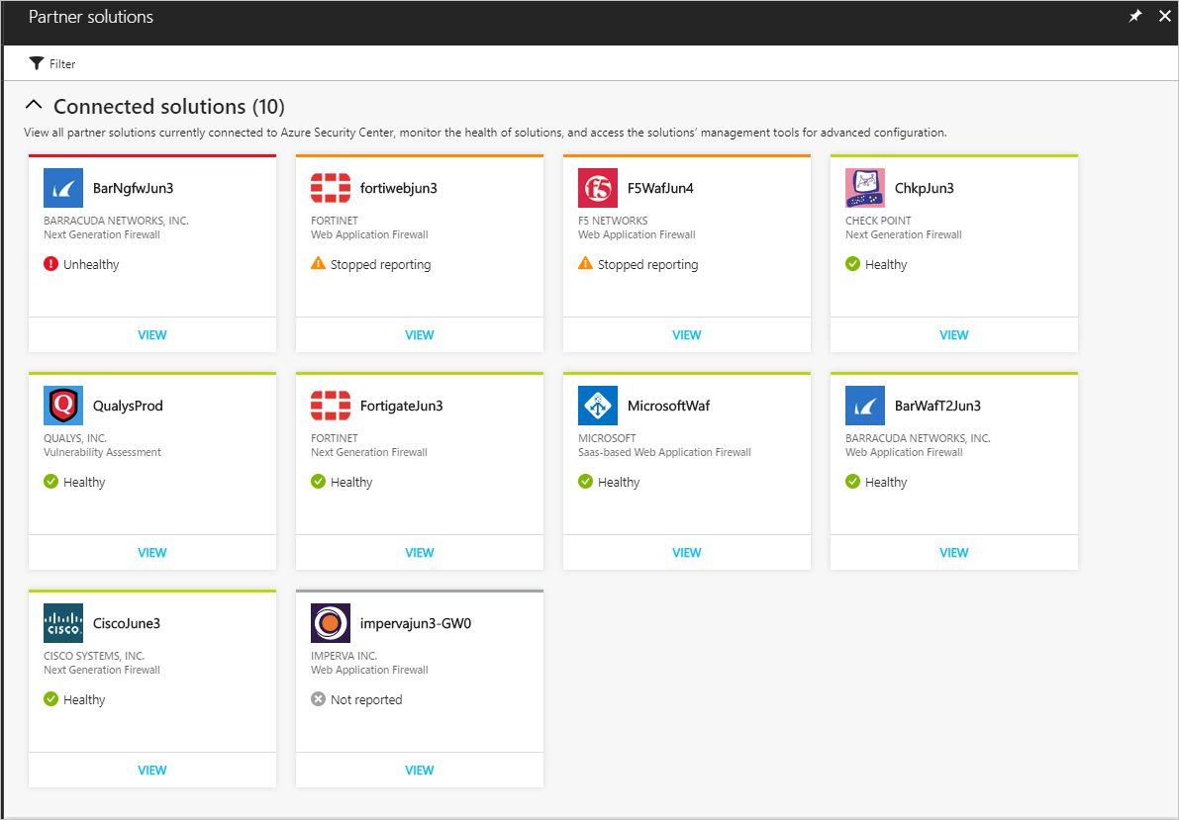
Integrated Solutions
VENDORS
Trend Micro
Microsoft Antimalware
Barracuda
F5
Imperva
Fortinet
Azure Application Gateway
Check Point
Cisco
Qualys

Slide 33
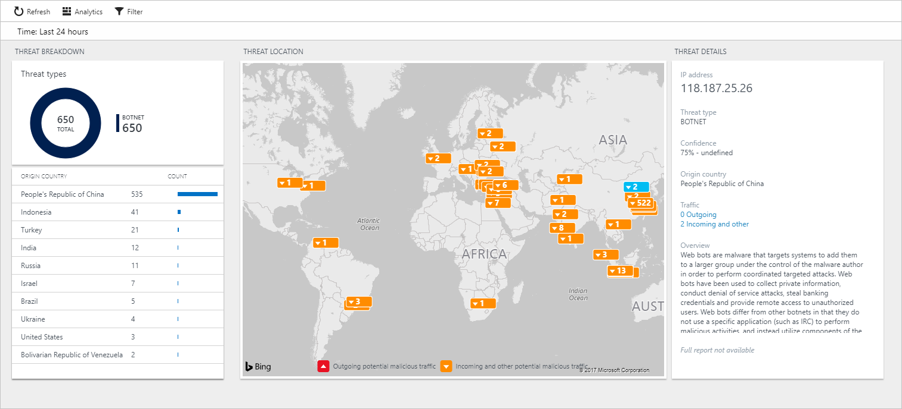
Log Analytics Integration – Threat Intel Map
VENDORS

Slide 34
Security Roles
Role | Edit security policy | Apply security recommendations for a resource | Dismiss alerts and recommendations | View alerts and recommendations
Subscription Owner | X | X | X | X
Subscription Contributor | X | X | X | X
Resource Group Owner | -- | X | -- | X
Resource Group Contributor | -- | X | -- | X
Reader | -- | -- | -- | X
Security Administrator | X | -- | X | X
Security Reader | -- | -- | -- | X
Notes:
RESOURCE GROUPS
Management Services
Automation Account
OMS Workspace
Custom Image
Azure DNS
Key Vault
Azure Backup
Azure Storage
Shared Services
Virtual Network
VPN Gateway
Virtual Machine
Azure Load Balancer
Sports League App
Virtual Network
VNET Peering
Application Gateway
Azure Load Balancer
Azure Storage
Virtual Machine
VM Scale Set
MANAGEMENT ROLES
Administrators
Account Access
Security Monitoring
Billing Management
Key Management
Network Contributors
Virtual Networks
Network Security
Hybrid Connectivity
Network Virtual Appliances
Infrastructure Contributors
Virtual Machines
Storage
Load Balancers
Custom Images
Performance Monitoring
BCDR Contributors
Data Backups
VM Backups
Workload Protection
Recovery Plan
Availability Monitoring

Slide 35
Azure Security Center – Add’l Info
Data Sources
Azure services
Network traffic
Partner solutions
Virtual Machines
Tiers
Basic: free version with most functionality
Standard:
Adaptive application controls
Network threat detection
VM threat detection
Advanced Services
Security Playbooks: a set of mitigation procedures triggered by a security alert, typically utilizing Azure Logic Apps
Adaptive app controls: creates a security baseline, including whitelisting for VMs using ML algorithms and audits anomalies
Just-in-time (JIT) VM access: enable on-demand, time-based access to VMs via Azure managed NSG rules
Security Policy Definitions
System updates
Security configurations
Endpoint protection
Disk encryption
Network security groups
Web application firewall
Next generation firewall
SQL auditing and threat detection
SQL encryption
Vulnerability assessment
Storage encryption
JIT network access
Configure policies using Azure Policy

Slide 36
Design an operations automation strategy

Slide 37
Azure Automation
Configure and automate operational tasks across a hybrid environment
Process Automation
Orchestrate processes with runbooks
Configuration Management
Collect inventory
Track changes
Configure desired state
Update Management
Assess compliance
Schedule installation
Azure, Windows, Linux
Community Gallery

Slide 38
Azure Automation – Shared capabilities
Role-based access control
“Automation operator” role = run yes, author no
Variables: use in multiple runbooks and configurations
Credentials: securely store for use by runbooks and configurations
Certificate storage
Connection information
Schedules: automation triggers
Source control integration
Powershell modules
Azure Automation Docs

Slide 39
Azure Automation Use Cases
Monitoring Configurations
Eliminate Configuration Drift
Automated Change of Configuration
Maintain Exact Configuration (override other changes)
Automated Testing
Automating Usage – Auto Start – Auto Stop
Automating Hybrid Scenarios
Automated Deployment
Implement DevOps practices
Notes:
Azure Automation is SaaS application
It automate processes with runbooks and manage configuration changes to Windows and Linux systems using Desired State Configuration (DSC) in Azure
Support other cloud services, or on-premises.
Runbooks that you run in Azure are executed on Automation sandboxes
To automate the deployment and management of resources in your local datacenter or other cloud services, after creating an Automation account, you can designate one or more machines to run the Hybrid Runbook Worker (HRW) role.
Each HRW requires the Microsoft Management Agent with a connection to a Log Analytics workspace and an Automation account.
Log Analytics is used to bootstrap the installation, maintain the Microsoft Management Agent, and monitor the functionality of the HRW.
The delivery of runbooks and the instruction to run them are performed by Azure Automation.
You can deploy multiple HRW to provide high availability for your runbooks, load balance runbook jobs,
and in some cases dedicate them for particular workloads or environments.

Slide 40
Azure Automation Runbook Types
Graphical
Include other runbooks as child runbooks for more modular programming
Can’t edit outside of Azure portal
Can’t edit PowerShell code directly
PowerShell
Runs faster than PowerShell workflow
More complex than graphical runbooks
Can’t use parallel processing or checkpoints
PowerShell Workflow
More complex coding required
Can be used with PowerShell or Graphical runbooks
Enables parallel processing
Python
Must be familiar with Python

Slide 41
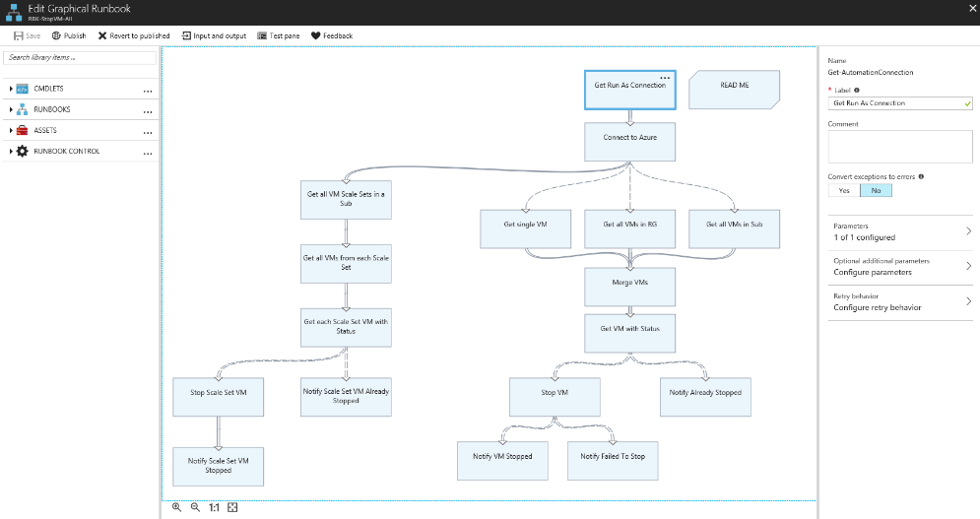
Azure Automation Graphical Runbook
Examples
Turn off non-prod VMs during off hours
Delete expired resources
Monitor connections and integrations
Respond to monitoring alerts
Produce compliance reports

Slide 42

Chef
https://www.chef.io/solutions
Cross-OS systems management, automation, and analytics output
Ruby and Git are required + agent is on target machine
Good for dev/ops teams (code-driven approach to configuration)
Use if:
You already use Chef to manage infrastructure
Your primary use case is managing Linux machines

Slide 43
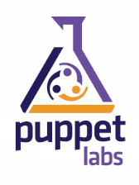
Puppet
https://puppet.com/solutions/configuration-management
Stable and mature, so good for managing large, heterogeneous enterprise environments
Automate systems configuration & enforce consistency
Large Open Source catalog of modules and runs on nearly every OS (cross platform)
Use if:
You already use Puppet to manage infrastructure
Your primary use case is managing Linux machines

Slide 44
Desired State Configuration (DSC)
DSC “by itself”: Powershell management platform for Windows, Linux
https://docs.microsoft.com/powershell/dsc/overview
Azure Automation DSC: adds capabilities
Built-in pull server – no need to deploy your own
Azure Automation management with other resources
Can send status data to Log Analytics
https://docs.microsoft.com/en-us/azure/automation/automation-dsc-overview
Use if:
You do not already have a Configuration Management solution
Your primary experience is managing Windows machines
You use vendor-neutral configuration files (MOF)
You already have Powershell expertise

Slide 45
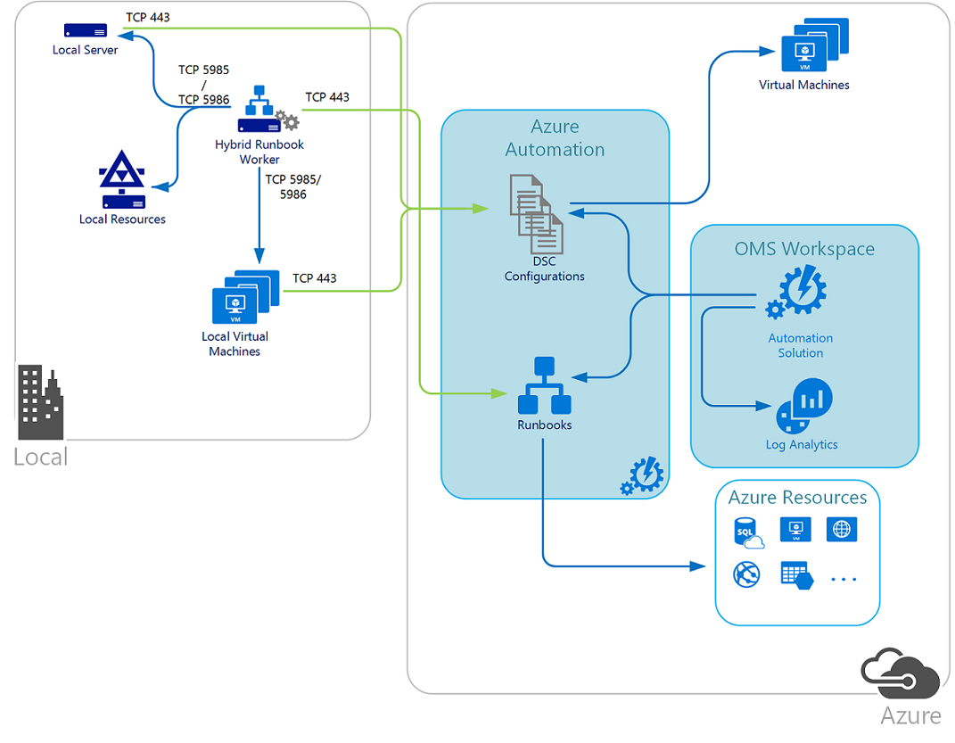
Hybrid Azure Automation - DSC
DSC configurations stored in Azure Automation can be directly applied to Azure virtual machines.
Other physical and virtual machines can request configurations from the Azure Automation DSC pull server.
Note
TCP 443 from local to Azure
TCP 5985/5986 Hybrid Runbook Worker to local machines and resources
Hybrid Runbook worker is running locally and managing local resources
https://docs.microsoft.com/en-us/azure/automation/automation-offering-get-started

Slide 46
Azure Event Grid
Fully-managed event routing
Near real-time event delivery at scale
Broad coverage within Azure and beyond
Backbone of event-driven computing
https://docs.microsoft.com/azure/event-grid
Notes:
https://docs.microsoft.com/en-us/azure/event-grid/

Slide 47
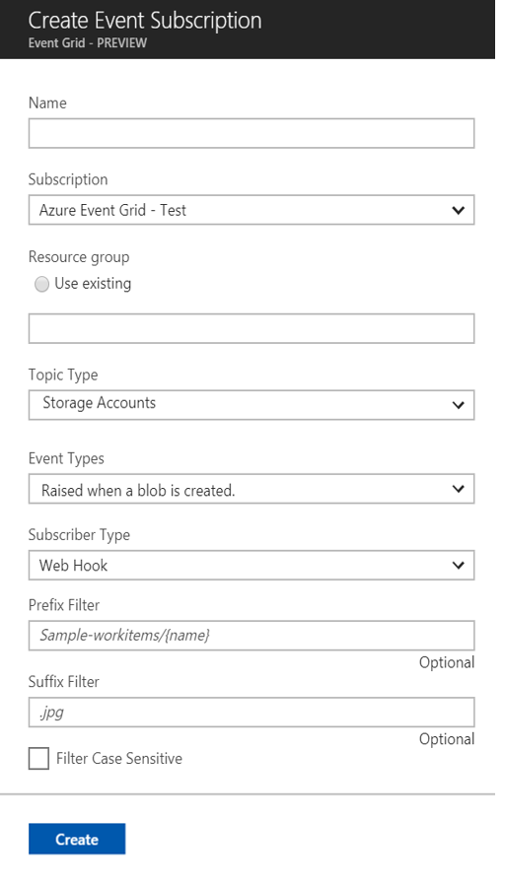


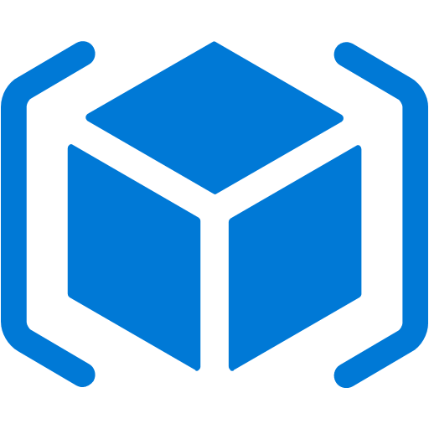
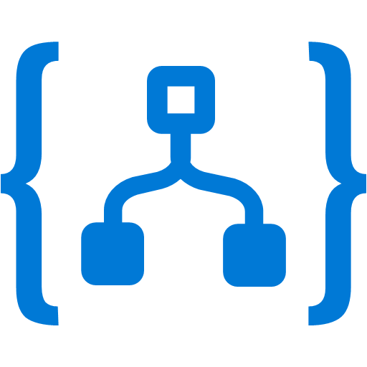


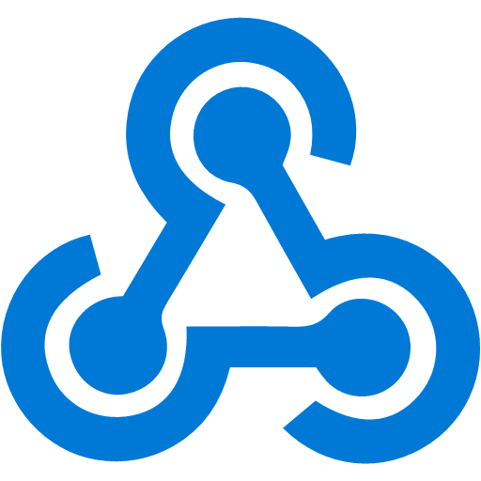

Manage all events in one place
Event publishers
Event handlers
Blob Storage
Azure Functions
Resource Groups
Subscribe to pre-defined system events in Azure or create your own custom topics
Logic Apps
Azure Subscriptions
Route events to any end-points, Azure or even beyond
Azure Automation
Event Hubs
WebHooks
Custom Events
Enable filtering and efficient routing of events
Notes:
Near Real Time
Sub-second end-to-end latency in the 99th percentile
Massive Scale Out
10,000,000 events per second per region
Highly Reliability
24-hour retry with exponential back off for events not delivered

Slide 48
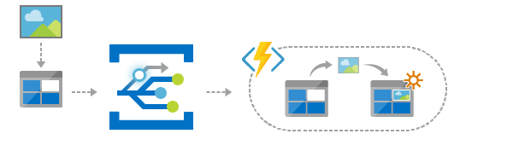
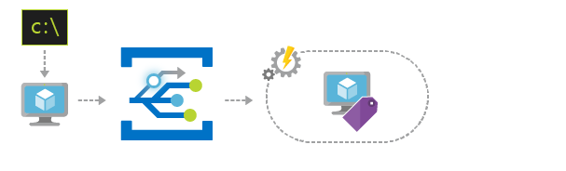
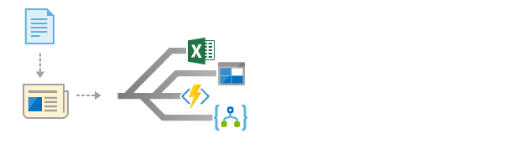
Scenarios
Serverless apps
Ops automation
Application integration
Instantly trigger a serverless function to run analysis when a new file is added to a blob storage container.
Speed up automation and simplify policy enforcement by notifying Azure Automation when underlying infrastructure is provisioned
Connects your app with other services. Create an application topic to route your app’s event data to any desired destination

Slide 49
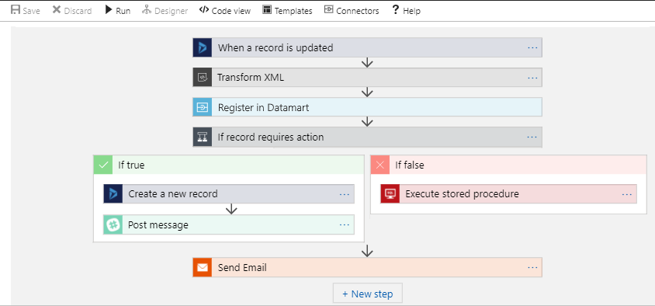
Logic Apps: Automate Repeatable Tasks
Connectors
Azure Services
Office 365
SAP
Salesforce
Oracle

Slide 50
Logic Apps - More Info
Structure of a Logic App:
Triggers:
Webhook
Timer
Event – queue, email, file, tweet
Security: authenticated using SAS tokens
Conditions: for each, switch, if
Actions: operations on connectors or simple logic
Security:
SAS tokens encrypt keys for authentication
Firewalls can limit accessibility of HTTP triggers
Cost Model:
Every time the app runs
Per enterprise connector every time the app runs:
Standard connectors –Azure services, on-premises gateways, office 365, Salesforce
Enterprise connectors –SAP, MQ

Slide 51
Azure Scheduler
Describe and schedule actions to run on a schedule
Invokes actions
Azure, on-premise, other cloud
HTTP/S, Queue, Service Bus Topic
Does not host any workloads or run code
Job = single recurrent action
Job collections
Group jobs based on usage or app boundaries
Maintain settings, quotas, and throttles to constrain all jobs in collection
https://docs.microsoft.com/azure/scheduler

Slide 52
Topics in Motion - Recent changes to 70-535 exam - Moved from Operations to Compute objective

Slide 53
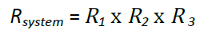
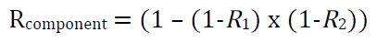
Azure SLAs
Composite
SLA
99.949%
0.9995 x 0.99999775 x 0.99999775 x 0.99999775
DMZ
99.95%
99.95%
App Gateway
System Availability
99.95%
99.95%
99.999775%
0.9995 x 0.999 = 0.9985
(1 - (1-0.9985) x (1-0.9985)) = 0.99999775
WEB
x
x
VM Scale Set
99.9%
99.9%
99.95%
Dual Modular Redundancy
99.95%
99.999775%
0.9995 x 0.999 = 0.9985
(1 - (1-0.9985) x (1-0.9985)) = 0.99999775
APP
x
x
VM Scale Set
99.9%
99.9%
99.95%
99.95%
99.999775%
0.9995 x 0.999 = 0.9985
(1 - (1-0.9985) x (1-0.9985)) = 0.99999775
DATA
x
x
SQL AlwaysOn
99.9%
99.9%

Slide 54
VM Availability
Fault Domains (2-3)
Upgrade Domains (20)
FD 1
FD 2
FD 3
FD 1
FD 2
FD 3
UD 1
UD 2
UD 3
UD 4
UD 5
UD 6
UD 7
UD 8
UD 9
UD 10
Availability Set
VM 1
VM 2
VM 3
VM 4
Storage 1
Storage 2
Storage 3
Storage 4
Stamp A
Stamp B
Stamp C

Slide 55
Local Workload Protection
1
2
5
4
3

Slide 57
Appendix

Slide 58
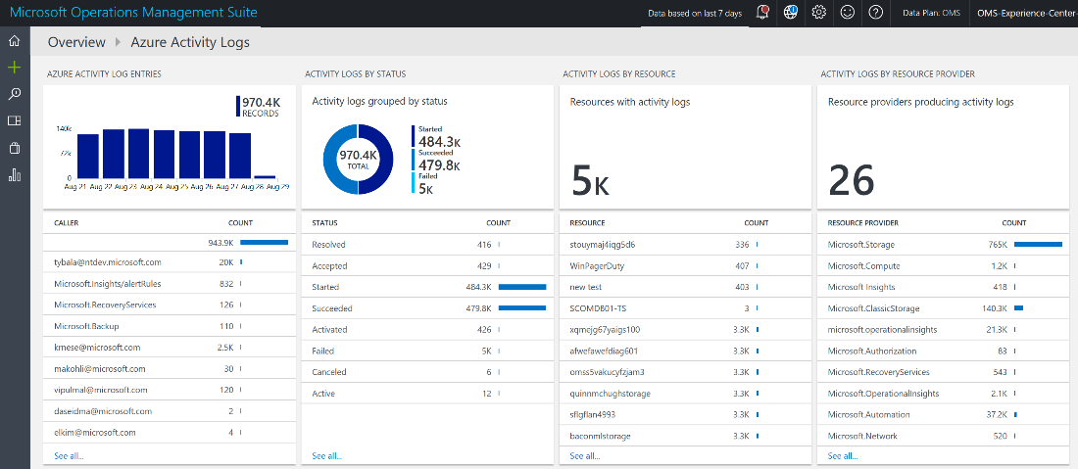
Activity Logs
Activity reports from Azure’s Log Analytics Service
Monitor…
Service usage characteristics
Service errors and deployment failures
Newly created resource instances
Custom audit events
Specific user activity

Slide 59
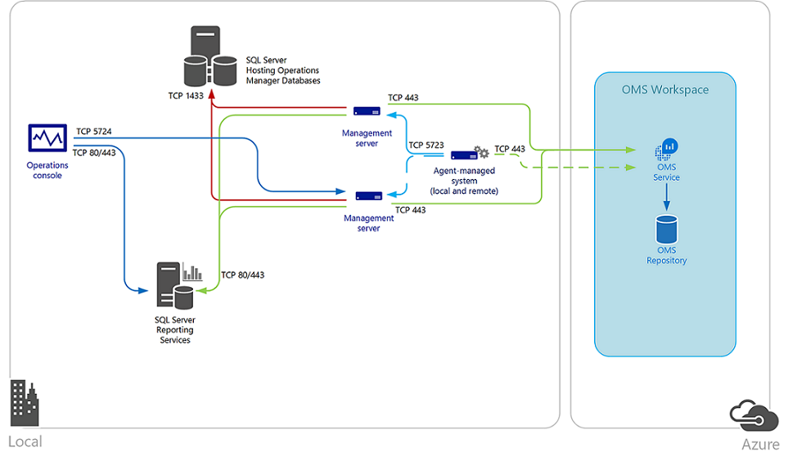
System Center Integration with Log Analytics
Communication
Management Server → Log Analytics web service
Agents –Log Analytics web services
OMS Gateway service → Log Analytics web services
Benefits
Continue monitoring the health of your IT services with Operations Manager
Maintain integration with your ITSM solutions supporting incident and problem management
Manage the lifecycle of agents deployed to on-premises and public cloud IaaS virtual machines that you monitor with Operations Manager

Slide 60
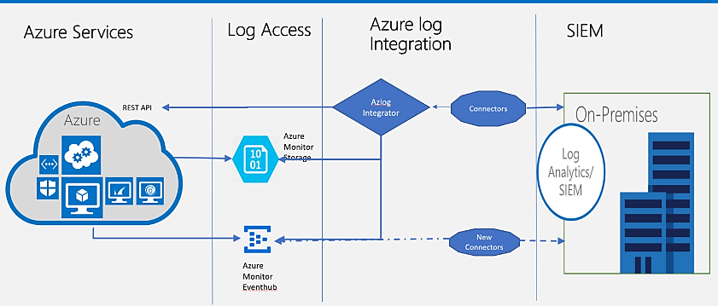
Export Log Data
AAD Audit Logs
Azure Activity Logs
Azure Security Center Alerts
Resource Diagnostics Logs

Slide 61
VM Maintenance
Maintenance Events
Recovery Modes
Unplanned Maintenance
Predicted hardware failure
Always uses Live Migration
Failure Event
Automatic VM healing to new host
Planned Maintenance
No advanced notice
Requires Full Upgrade
Regularly executes patches using Live Migration
Major updates require Full Upgrade
Offers On-Demand Maintenance
Full Upgrade
Applied UD by UD
Once every 12-16 months
Live Migration
Default update technique
< 30 sec VM pause
On-Demand Maintenance
30 day advanced notice
Customer initiated window
VM reboot
Preserves disk content

Slide 62
VM SLAs
INDUSTRY-ONLY
INDUSTRY-LEADING HIGH AVAILABILITY SLA
INDUSTRY-LEADING DISASTER RECOVERY
VM SLA
VM SLA
VM SLA
REGIONS 42
99.9%
99.95%
99.99%
Region 1
Region 2
SINGLE VM
AVAILABILITY SETS
AVAILABILITY ZONES
REGION PAIRS
Protection with Premium Storage
Protection against failures within datacenters
Protection from entire datacenter failures
Protection from disaster with Data Residency compliance

Slide 63

Azure Datacenter

Slide 64

Regional Workload Protection - >0 RTO
RESOURCES
PROTECTION
ARM
Template
Central Hub Network
Domain Ctrl
Backup Svr
Azure US West
VPN
NVA
Jump Box
VPN
VNET Peering
App Spoke Network
VM Disk Replication
Azure Site Recovery
Disk Storage
Recovery Plan
SQL Secondary
Domain Ctrl
Web Scale Set
App Scale Set
App Gateway
SQL AlwaysOn
SQL Async Replication
Notes:
RESOURCE GROUPS
Management Services
Automation Account
OMS Workspace
Custom Image
Azure DNS
Key Vault
Azure Backup
Azure Storage
Shared Services
Virtual Network
VPN Gateway
Virtual Machine
Azure Load Balancer
Sports League App
Virtual Network
VNET Peering
Application Gateway
Azure Load Balancer
Azure Storage
Virtual Machine
VM Scale Set
MANAGEMENT ROLES
Administrators
Account Access
Security Monitoring
Billing Management
Key Management
Network Contributors
Virtual Networks
Network Security
Hybrid Connectivity
Network Virtual Appliances
Infrastructure Contributors
Virtual Machines
Storage
Load Balancers
Custom Images
Performance Monitoring
BCDR Contributors
Data Backups
VM Backups
Workload Protection
Recovery Plan
Availability Monitoring

Slide 65
Regional Workload Protection – near (=)0 RTO
RESOURCES – US East
RESOURCES – US West
INTERNET
Central Hub Network
Central Hub Network
Domain Ctrl
Domain Ctrl
Backup Svr
Backup Svr
VPN
NVA
NVA
VPN
Jump Box
Jump Box
Azure
Traffic Manager
VNET Peering
VNET Peering
App Spoke Network
App Spoke Network
Web Scale Set
Web Scale Set
Routing Methods
Priority: failover pattern
Weighted: A/B testing pattern
Performance: latency dependent routing
Geographic: geo-mapped endpoints
App Scale Set
App Gateway
App Gateway
App Scale Set
SQL AlwaysOn
(primary)
SQL AlwaysOn
(secondary)
SQL async replication
Notes:
RESOURCE GROUPS
Management Services
Automation Account
OMS Workspace
Custom Image
Azure DNS
Key Vault
Azure Backup
Azure Storage
Shared Services
Virtual Network
VPN Gateway
Virtual Machine
Azure Load Balancer
Sports League App
Virtual Network
VNET Peering
Application Gateway
Azure Load Balancer
Azure Storage
Virtual Machine
VM Scale Set
MANAGEMENT ROLES
Administrators
Account Access
Security Monitoring
Billing Management
Key Management
Network Contributors
Virtual Networks
Network Security
Hybrid Connectivity
Network Virtual Appliances
Infrastructure Contributors
Virtual Machines
Storage
Load Balancers
Custom Images
Performance Monitoring
BCDR Contributors
Data Backups
VM Backups
Workload Protection
Recovery Plan
Availability Monitoring

Slide 66
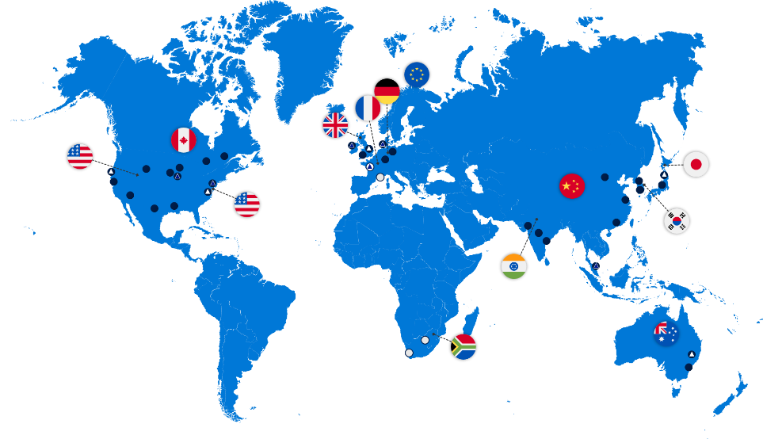
Paired Regions / Data Residency Geos
Geography | Region 1 | Region 2
Asia | East Asia | Southeast Asia
Australia | Australia East | Australia Southeast
Canada | Canada Central | Canada East
China | China North | China East
India | Central India | South India
Japan | Japan East | Japan West
Korea | Korea Central | Korea South
North America | North Central US | South Central US
North America | East US | West US
North America | East US 2 | Central US
North America | West US 2 | West Central US
Europe | North Europe | West Europe
Japan | Japan East | Japan West
Brazil | Brazil South (1) | South Central US
US Government | US Gov Iowa | US Gov Virginia
US Government | US Gov Virginia | US Gov Texas
US Government | US Gov Texas | US Gov Arizona
UK | UK West | UK South
Germany | Germany Central | Germany Northeast

Slide 67
Point-in-Time Workload Protection
RESOURCES
PROTECTION
Central Hub Network
System State Backup
Domain Ctrl
Monitoring
Azure US East
VPN
NVA
Jump Box
Storage Account
Azure Backup
3x copies
VNET Peering
VM + File/Folder Snapshot
App Spoke Network
Web Scale Set
Azure US West
App Scale Set
App Gateway
3x copies
Storage Account
SQL AlwaysOn
SQL Backup to URL
Notes:
RESOURCE GROUPS
Management Services
Automation Account
OMS Workspace
Custom Image
Azure DNS
Key Vault
Azure Backup
Azure Storage
Shared Services
Virtual Network
VPN Gateway
Virtual Machine
Azure Load Balancer
Sports League App
Virtual Network
VNET Peering
Application Gateway
Azure Load Balancer
Azure Storage
Virtual Machine
VM Scale Set
MANAGEMENT ROLES
Administrators
Account Access
Security Monitoring
Billing Management
Key Management
Network Contributors
Virtual Networks
Network Security
Hybrid Connectivity
Network Virtual Appliances
Infrastructure Contributors
Virtual Machines
Storage
Load Balancers
Custom Images
Performance Monitoring
BCDR Contributors
Data Backups
VM Backups
Workload Protection
Recovery Plan
Availability Monitoring

Slide 68
Azure Backup Scenarios
Azure VM Extension: VMs, disks, files, folders
MARS Agent: Windows only files and folders
Azure Backup Server: VMs, volumes, files, folders, apps
Azure SQL DB Long Term Retention: SQL DB backup files
Azure Storage Snapshots: Azure Files shares
Managed Backup for SQL Server: SQL in a VM backup files
3x copies
Azure Storage
MARS Agent
Azure VM
3x copies
VM
Azure Backup
Local Disk
Azure Storage
VM Cluster
Azure Backup Server
SQL Server in Azure VM
Azure Files
Azure SQL DB

Slide 69
Design Patterns for a Distributed System
WEB
Cache
CDN
APP
API Management
Queue
Worker
DATA
Retry
Circuit Breaker
Anti-Corruption Layer
Ambassador
Notes:
RESOURCE GROUPS
Management Services
Automation Account
OMS Workspace
Custom Image
Azure DNS
Key Vault
Azure Backup
Azure Storage
Shared Services
Virtual Network
VPN Gateway
Virtual Machine
Azure Load Balancer
Sports League App
Virtual Network
VNET Peering
Application Gateway
Azure Load Balancer
Azure Storage
Virtual Machine
VM Scale Set
MANAGEMENT ROLES
Administrators
Account Access
Security Monitoring
Billing Management
Key Management
Network Contributors
Virtual Networks
Network Security
Hybrid Connectivity
Network Virtual Appliances
Infrastructure Contributors
Virtual Machines
Storage
Load Balancers
Custom Images
Performance Monitoring
BCDR Contributors
Data Backups
VM Backups
Workload Protection
Recovery Plan
Availability Monitoring

